Slide 1
Support Vector Machine

Slide 2
Agenda
SVM basics
SVM Objective Function
Slack Variable
Kernel Trick
SVM Hyperparameters
Coding

Slide 3
AI / ML
Machine Learning
Using Computer algorithms to uncover insights, determine relationships , and make prediction about future trends.
Artificial Intelligence
Enabling computer systems to perform tasks that ordinarily requires human intelligence.
We use machine learning methods to create AI systems.

Slide 4
Machine Learning Paradigms
Unsupervised Learning
Find structure in data. (Clusters, Density, Patterns)
Supervised Learning
Find mapping between features to labels

Slide 5
From Data to Decisions…
Insights
Features
Domain Knowledge
Models
Data
Predictions
Decision
Business Objectives
Business Constraints
Feedback

Slide 6
Support Vector Machine
Supervised machine learning Algorithm.
Can be used for Classification/Regression.
Works well with small datasets

Slide 7
Classification
Classification using SVM
2 class problem , linearly separable data

Slide 8
The “Best” Separation Boundary
This is the widest road that separates the two groups

Slide 9
The “Best” Separation Boundary

Slide 10
The “Best” Separation Boundary

Slide 11
The “Best” Separation Boundary
This is the widest road that separates the two groups

Slide 12
The “Best” Separation Boundary
This is the widest margin that separates the two groups
Margin

Slide 13
The “Best” Separation Boundary
The distance between the points and the line are as far as possible.
Margin

Slide 14
The “Best” Separation Boundary
The distance between the support vectors and the line are as far as possible.
Support Vectors
Margin

Slide 15
The “Best” Separation Boundary
Support Vectors
This hyperplane is an optimal hyperplane because it is as far as possible from the support vectors.
Hyperplane
Maximum Margin

Slide 16



Decision Rule
u
w : normal vector of any length
u : unknown vector and we want to find it belongs to which class?
+
-
+
+
Then unknown vector will be classified as
Projection
-
w

Slide 17



Constraints
0
Constraint for positive samples
+
+
-
1
+
-
Likewise for negative samples
-1
-

Slide 18

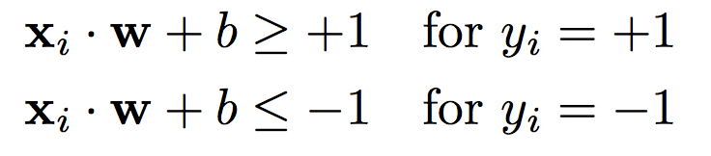



Combining Constraints
Constraint for positive samples
Constraint for negative samples
+
To bring above inequalities together we introduce another variable
-
0
+
0
-
For support vectors

Slide 19


Width
+
On the equation above x+ and x− are in the gutter (on hyperplanes maximizing the separation).
-
+
w
Positive Samples
-
Likewise Negative Samples

Slide 20
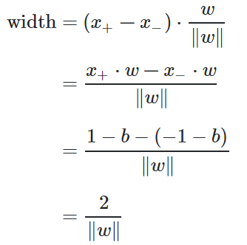

Width
+
-
+
w
-
Margin
Maximize

Slide 21
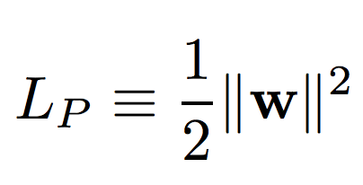
SVM Objective
OBJECTIVE:
+
(Minimize)
-
+
w
CONSTRAINT:
-
Constrained Optimization problem.

Slide 22
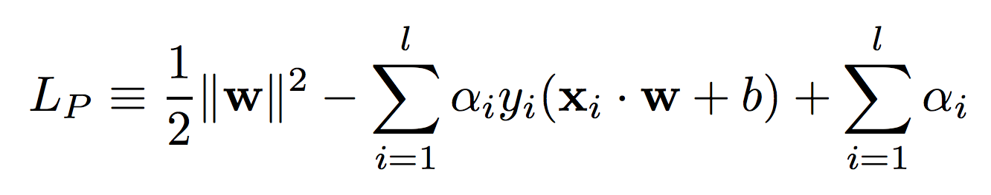
Lagrangian
OBJECTIVE:
CONSTRAINT:
Lagrange Multipliers

Slide 23
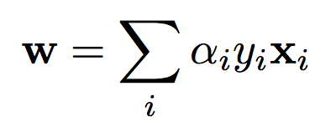
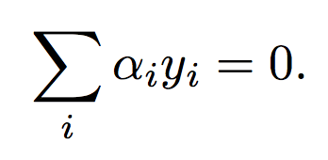
Solving the PRIMAL
The normal vector w are the linear combination of support vectors

Slide 24
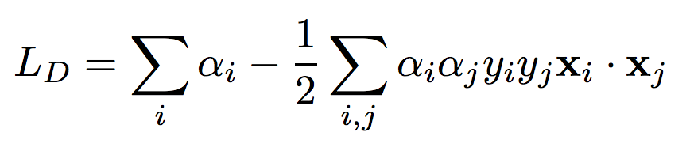
PRIMAL → DUAL

Slide 25
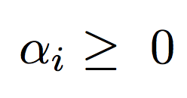
SVM Objective (DUAL)
OBJECTIVE: Minimize
CONSTRAINT:
SVM objective will depend only on the dot product of pairs of support vector.

Slide 26


Decision Rule
So whether a new sample will be on the right of the road depends on the dot product of the support vectors and the unknown sample.

Slide 27
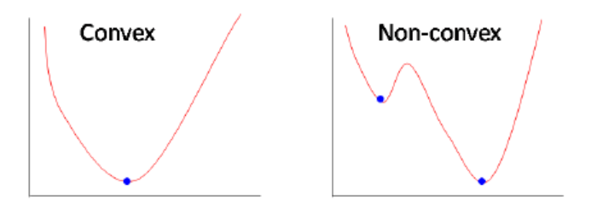
Points to Consider
SVM problem is constrained minimization problem
To find the widest road between different samples we just need to consider dot products of support vectors .

Slide 28
Slack variable

Slide 29
Separable Case
+
-
+
-
w

Slide 30
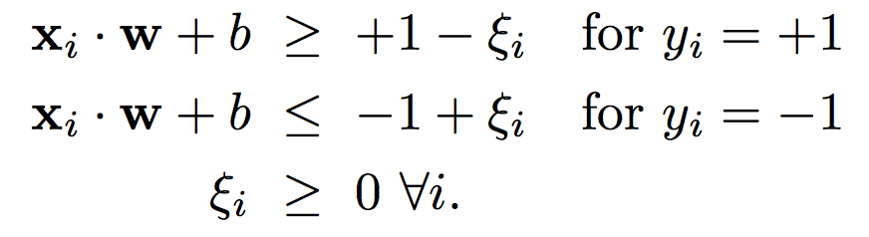
Non-Separable
-
+
-
Slack Variables
+
-
+
w

Slide 31
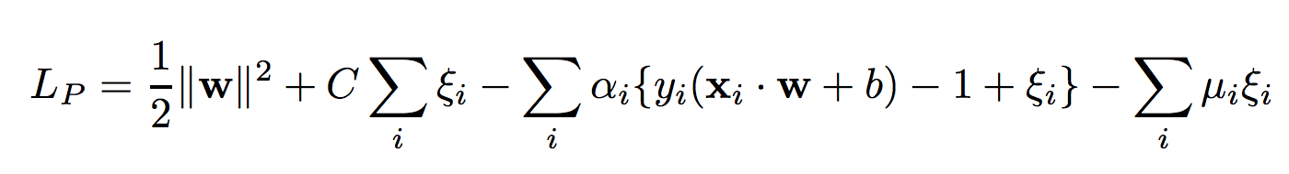
PRIMAL Objective
LINEARLY SEPARABLE CASE
LINEARLY NON-SEPARABLE CASE

Slide 32

DUAL Objective
LINEARLY SEPARABLE CASE
LINEARLY NON-SEPARABLE CASE

Slide 33
KERNEL TRICK

Slide 34
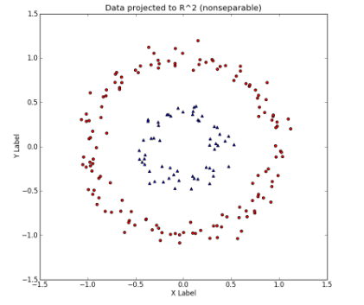
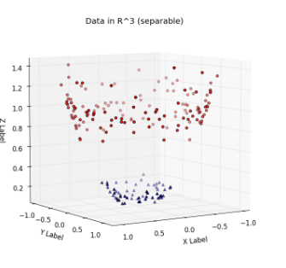
Increasing Model Complexity
Non linear dataset with n features (~n-dimensional)
Match the complexity of the data by the complexity of the model.
Linear Classifier ?
Improve accuracy by transforming
input feature space.
For datasets with a lot of features,
it becomes next to impossible to try out all the interesting transformations.
https://www.youtube.com/watch?v=3liCbRZPrZA

Slide 35
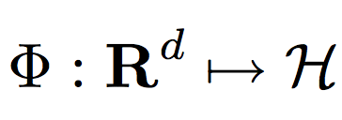
Increasing Model Capacity
LINEAR CLASSIFIERS
GENERALIZED LINEAR CLASSIFIERS

Slide 36
KERNEL TRICK

Slide 37
Kernel Trick
For a given pair of vectors (in a lower-dimensional feature space) and a transformation into a higher-dimensional space, there exists a function (The Kernel Function) which can compute the dot product in the higher-dimensional space without explicitly transforming the vectors into the higher-dimensional space first
KERNEL FUNCTION

Slide 38
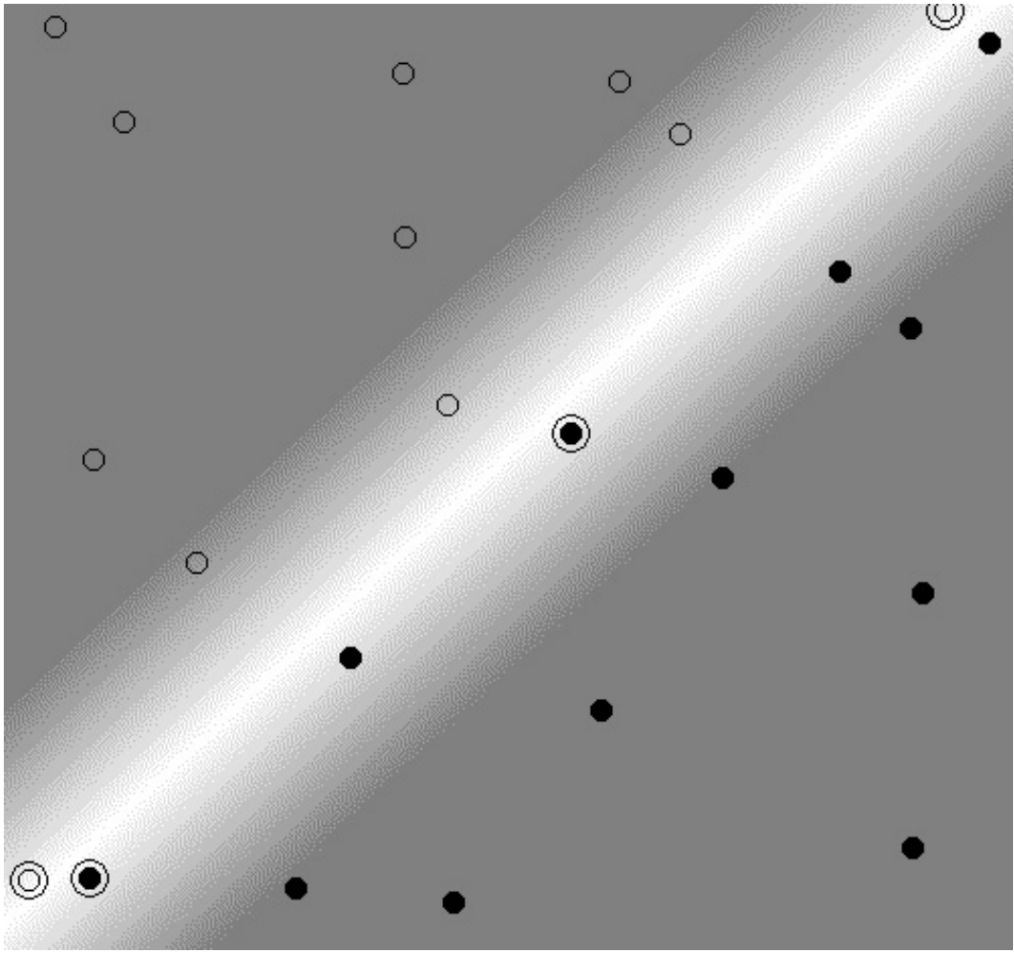
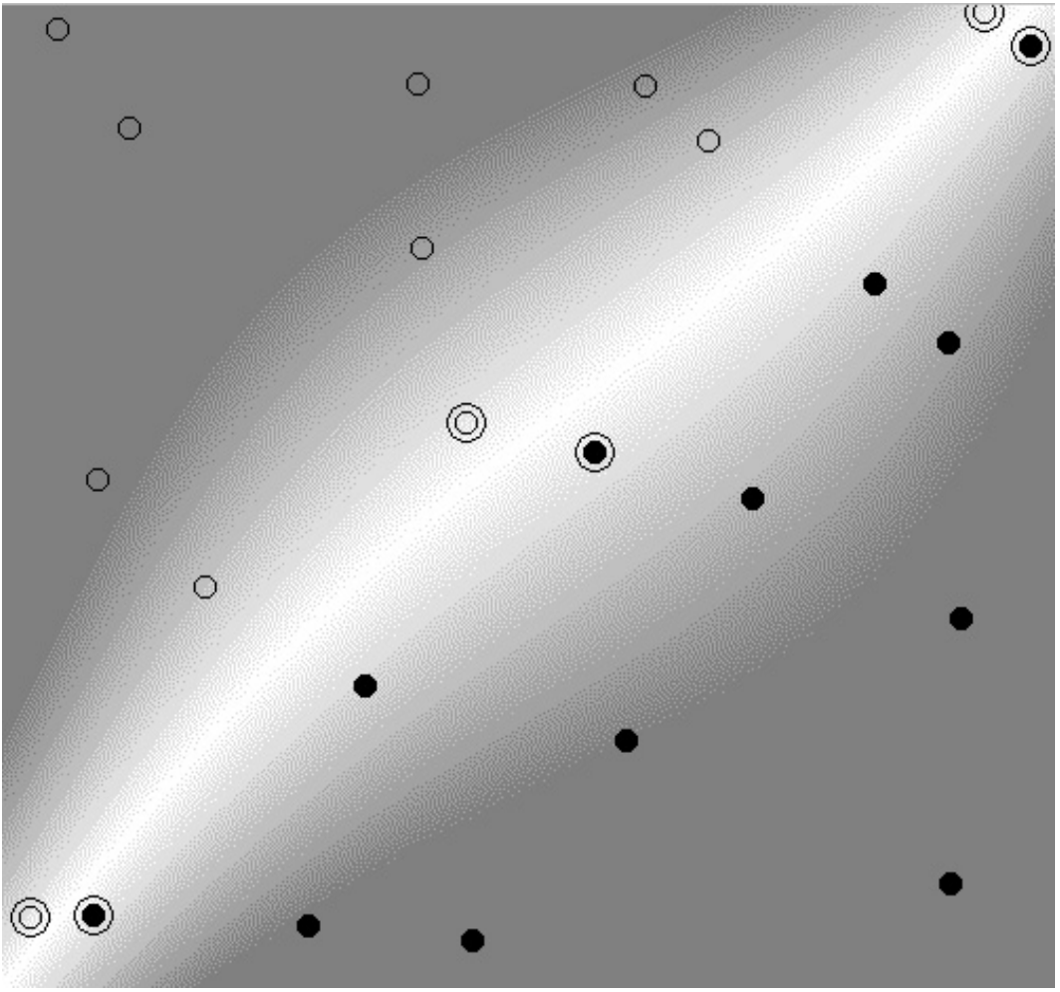
Polynomial Kernel / Separable

Slide 39
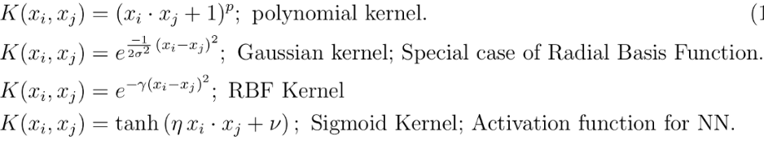
Kernel functions

Slide 40
SVM Hyperparameters
Parameter C : Penalty parameter
Parameter gamma : Specific to Gaussian RBF
Large Value of parameter C => small margin
Small Value of parameter C => Large margin
Large Value of parameter gamma => small gaussian
Small Value of parameter gamma => Large gaussian

Slide 41
Code

Slide 42
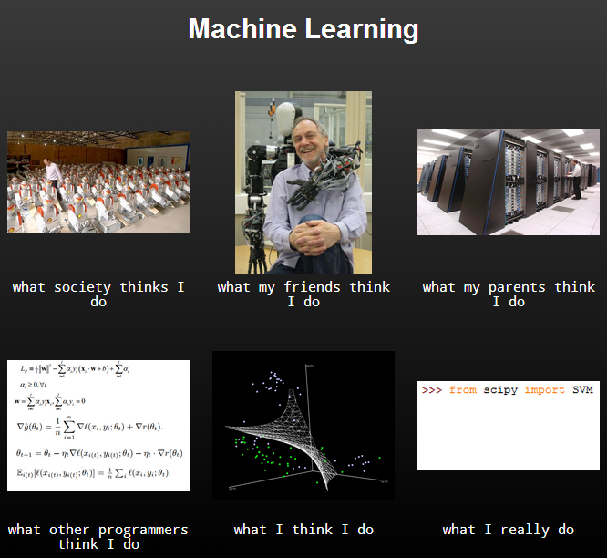
What I really do?

Slide 43

Questions

Slide 44
Source
https://www.quora.com/What-are-C-and-gamma-with-regards-to-a-support-vector-machine
https://www.quora.com/How-can-I-choose-the-parameter-C-for-SVM
https://www.youtube.com/watch?v=_PwhiWxHK8o
https://www.youtube.com/watch?v=N1vOgolbjSc
https://medium.com/@pushkarmandot/what-is-the-significance-of-c-value-in-support-vector-machine-28224e852c5a
https://towardsdatascience.com/understanding-support-vector-machine-part-1-lagrange-multipliers-5c24a52ffc5e
https://towardsdatascience.com/understanding-support-vector-machine-part-2-kernel-trick-mercers-theorem-e1e6848c6c4d
http://web.mit.edu/6.034/wwwbob/svm-notes-long-08.pdf
https://www.quora.com/What-is-the-kernel-trick

